Slide 1


3 Secrets to talking with your kids & have them listen
Developing mutual respect between you and your child.

Slide 2

Objective:
During the course of this seminar we will explore 3 secrets that will help you communicate more effectively with your child and improve co-operation.
Here are the 3 Secrets we will cover:
Check yourself first
Connect before you direct.
State your expectations

Slide 3

1. Check yourself first:
Before you open your mouth to speak stop and think . Ask yourself some relevant questions such as,
  “Am I overreacting?
  Is my child being defiant or just expressing his desires?
  Is what I am asking or expecting reasonable for his age and ability?
  What am I feeling right now?
  How can I convey my message without attacking his character?

Slide 4
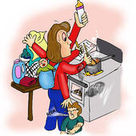
2. Connect Before You Direct:
Before giving directions make sure you have their complete attention. Of course this means you need to give them yours.
Call them by their name. Depending on the nature of your request, it is usually best to use their given name rather than a nick name. This allows them to know that your request is serious and that you expect them to comply.
Make eye contact. Squat to their eye level and say something like this. “(Their name), I need your eyes to look at me, (or your ears to listen to me).
Reduce the distractions such as TV, Video games etc.
State your request in a calm and warm manner.
Use a respectful tone and attach please in your request.
Get their feedback. This is especially important with children with short attention spans.
Compliment them for understanding your words then acknowledge what has been completed

Slide 5
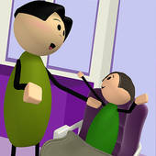
3. State Your Expectations
The best way to reduce the need to troubleshoot is to keep your child in the loop of what is happening. In other words let her in on the agenda.
Give a very brief overview of what will be happening in the next short while.
State clearly what her role will be and exactly what your expectations of her will be.
Maintain a calm demeanor and use a respectful tone.
Use terms such as “I expect”, “I need you to…” “I want you to…” in your sentence.
For example: “Suzie, in five minutes we will be leaving and I expect you to have your coat and shoes on please.”

